Slide 1
2.8 Wrapper Classes

Slide 2
Wrapper classes
Wrapper classes are used to store primitive types inside of ordinary Java classes. Integer is a Java class, while int is not.
Integer has a single attribute storing the value of the int used to create the instance.
Constructors:
Integer i = new Integer(4); Double d = new Double(2.718);
Getters:
int j = i.intValue(); double e = d.doubleValue();

Slide 3
Wrapper classes
A variable whose type is a wrapper class like Integer, like any other class, is a reference to an object instance, not an object instance itself.
Using a wrapper class instead of a primitive type means more memory accesses, which is slower, and more memory used.
Wrapper object instances are also called "boxed primitives" – see the box?
Integer i = new Integer(4);
int j = 3;
Integer instance
i
3
j
3

Slide 4
Wrapper classes exist for every primitive type
Every primitive type in Java has a corresponding wrapper class.
boolean | java.lang.Boolean
byte | java.lang.Byte
char | java.lang.Character
double | java.lang.Double
float | java.lang.Float
int | java.lang.Integer
long | java.lang.Long
short | java.lang.Short

Slide 5
java.lang.Number
Wrapper classes for the numeric types all share the same parent class, java.lang.Number, whose parent class is java.lang.Object.
From java.lang.Number, all of those wrapper classes get these methods:
byte byteValue()
double doubleValue()
float floatValue()
int intValue()
long longValue()
short shortValue()
Object
Number
Byte
Float
Integer
Long
Double
Short

Slide 6
Autoboxing and unboxing
Originally, Java programmers had to explicitly convert between primitive types and the equivalent wrapper objects.
In Java 1.5 (released 9/30/2004), autoboxing and unboxing were added.
Autoboxing:
Integer i = 4; is the same as Integer i = new Integer(4);
Unboxing:
int j = i; is the same as int j = i.intValue();

Slide 7
Wrapper classes are immutable
The wrapper classes are immutable, like String. Once you create an instance of Integer, you can't change the int inside it.
The wrapper classes have getter methods like intValue(), doubleValue(), booleanValue(), floatValue(), but no setter methods.
Integer i = 3;
i = 5; ← This is really creating a whole new Integer object instance, and reassigning the value of i.

Slide 8
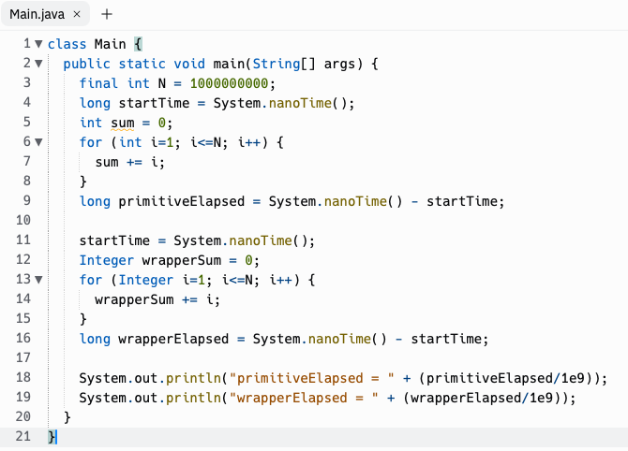
Benchmarking int vs Integer

Slide 9
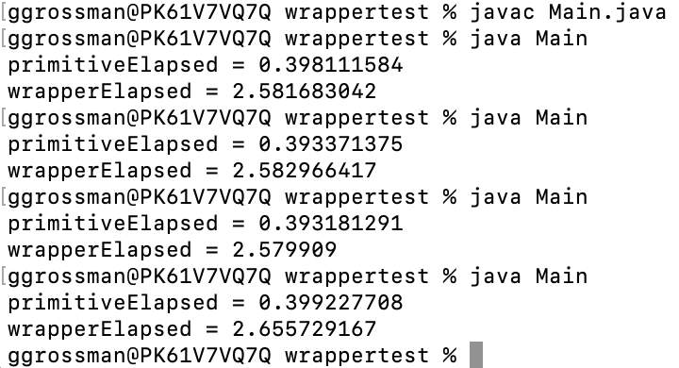
Benchmarking int vs Integer: Results

Slide 10
Why even use wrapper classes?
They contain useful methods and attributes:
Integer.parseInt(string) converts a string representation of an integer into an int
Integer.MIN_VALUE and Integer.MAX_VALUE store the largest and smallest possible 32-bit integers your computer can store. These lower and upper bounds on all computable integers are very useful in algorithm development
Storing primitive types within classes enables us to use Java language constructs that can only be applied to classes…
More on this later with Arrays and Maps

Slide 11
Java uses the wrapper classes for its own purposes
We learned that string concatenation will do string conversion, that is, convert other types to String before concatenating them. It does this using the wrapper classes.
String s = "Temperature: " + currentTemp + " Frozen: " + isFrozen();
This is equivalent to
String s = "Temperature: " + new Integer(currentTemp).toString() + "Frozen: " + new Boolean(isFrozen()).toString();
(The JVM probably optimizes this heavily but this is the idea.)
Reference: Java Language Specification, Section 5.1.11

Slide 12
Integer.MIN_VALUE, Integer.MAX_VALUE
Each numeric wrapper type has a MIN_VALUE, MAX_VALUE.
Integer.MIN_VALUE = -2147483648, Integer.MAX_VALUE = 2147483647
Why? int is 32-bit. The biggest binary number would be all 1's, but we reserve the MSB (Most Significant Bit) to represent positive/negative, called the sign bit.
b31
b0
01111111111111111111111111111111
2³¹
2³⁰
2²⁹
2²⁸
2²⁷
2²⁶
2²⁵
2²⁴
2²³
2²²
2²¹
2²⁰
2¹⁹
2¹⁸
2¹⁷
2¹⁶
2¹⁵
2¹⁴
2¹³
2¹²
2¹¹
2¹⁰
2⁹
2⁸
2⁷
2⁶
2⁵
2⁴
2³
2²
2¹
2⁰
In a decimal number, the least place is multiplied by 10⁰, the tens place by 10¹, hundreds by 10². In binary, you instead multiply by 2⁰, 2¹, 2², ...
So the above number is 2⁰+2¹+2²+2³+2⁴+2⁵+...+2³⁰ = 2³¹-1 = 2147483647
9999
10³
10²
10¹
10⁰

Slide 13
Two's Complement (2^{n}-x)
Computers usually use this scheme for representing negative numbers. The MSB is the sign bit. To negate a number, you invert every bit and then add 1. So the number 1 as an int is
00000000000000000000000000000001
First, we invert all the bits.
11111111111111111111111111111110
Then, we add 1, and this is the binary representation of -1 in two's complement.
11111111111111111111111111111111
What happens if you negate again? (Invert bits and add 1)

Slide 14
Two's Complement: Why?
Two's complement turns out to be a good system for representing negative numbers, because positive and negative numbers represented this way can be added/subtracted just like any numbers, and the two's complement results work out as expected.
1 + (-1) = 0
00000000000000000000000000000001
+11111111111111111111111111111111
00000000000000000000000000000000

Slide 15
Two's Complement: What happens when you overflow?
2147483647 + 1 = ????
01111111111111111111111111111111
+00000000000000000000000000000001
10000000000000000000000000000000

Slide 16
Two's Complement: What happens when you overflow?
2147483647 + 1 = -2147483648
01111111111111111111111111111111
+00000000000000000000000000000001
10000000000000000000000000000000
Integer.MAX_VALUE+1 == Integer.MIN_VALUE!

Slide 17
2.9: Using the Math Class

Slide 18

The Math Class
This class implements standard mathematical functions and constants.
Math has only static methods and attributes. It cannot be instantiated with the new operator… it has no public constructor!

Slide 19
The Math Class
You can prefix with Math. to access Math methods and attributes, or use static imports to bring some or all of Math into your code's default scope.
These two code samples are equivalent:
public class Main {
public static void main(String args[]) { System.out.println(Math.PI); System.out.println(Math.sqrt(9)); } }
import static java.lang.Math.*;
public class Main {
public static void main(String args[]) { System.out.println(PI); System.out.println(sqrt(9)); } }
Q: Why was no import statement required on the left?

Slide 20
Absolute Value
static int abs(int x) | Returns the absolute value of an int value
static double abs(double x) | Returns the absolute value of a double value
Remember from lesson 2.4:
Overloaded methods are two or more methods in the same class that have the same name but different parameters.

Slide 21
Calling abs method
Ex 1: int a = Math.abs(-4);
Ex 2: double b = Math.abs(-12.34);
Ex 3: int favoriteNumber = 3;
int c = Math.abs(favoriteNumber);

Slide 22
Power
static double pow(double base, double exp)
Returns base^{exp}.
Assumes base > 0, or base = 0 and exp > 0, or base < 0 and exp is an integer
(What happens if base < 0 and exp is not an integer? It returns NaN, which means "Not A Number." double can't represent imaginary numbers. Math.pow(-1, 0.5) is equivalent to Math.sqrt(-1), which also returns NaN since the answer is an imaginary number.)
P.S. Imaginary numbers can be represented in Java, but it's not built-in to the primitive data types or the standard library. You can use a third party library or write your own.

Slide 23
Calling pow method
Ex: double d = Math.pow(5, 2);

Slide 24

Square root
static double sqrt(double x)
Returns the positive square root of a double value.
(If x is negative, this will return NaN - Not A Number.)

Slide 25
Calling sqrt method
Ex: double e = Math.sqrt(144);

Slide 26
Random number
static double random()
Returns a double value greater than or equal to 0.0 and less than 1.0
Example:
double randomValue = Math.random();
// Example output: 0.6573016382857277

Slide 27
Write code that generates a random int between 0 to 9
int random = (int) (Math.random() * 10);

Slide 28
Write code that generates a random int between 1 and 10
int random = (int) (Math.random() * 10) + 1;

Slide 29
To see all the Math methods, look at the Java documentation!
https://docs.oracle.com/javase/8/docs/api/java/lang/Math.html

Slide 30
Practice on your own!
Go to replit.com and do the section2.8 and section2.9 exercises.
Try the CSAwesome lesson 2.8 exercises too.
Go to CSAwesome lesson 2.9 and complete the 5 multiple choice problems under Check your understanding
If you finish those, move on to the Programming Challenge towards the end of the lesson

